Slide 1



COVID - Agent Based Simulation
Group VII Members -
Jeel Bera
Chirag Mittal
Elias Khan
Daljeet Singh

Slide 2


Contents
Our Goals
Features
Used Technologies
Architecture
Future Plans
Demonstration

Slide 3
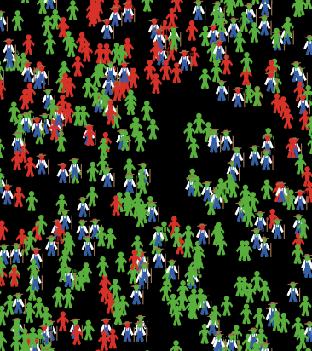

COVID SIMULATOR
- DEVELOPED IN NETLOGO

Slide 4
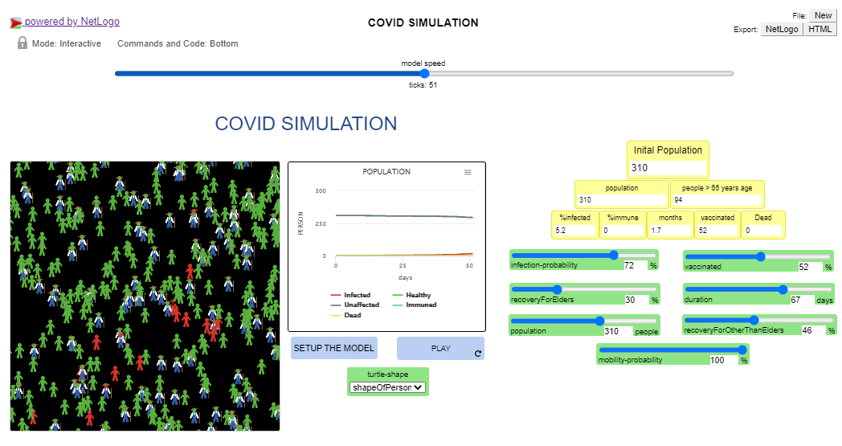
Goal
We aim to simulate the spread of Covid using Agent Based Simulation among different age groups and the how the use of vaccines is helping stop this spread, leading to positive impacts on the evolution of COVID-19.

Slide 5
FEATURES
Application would be useful for analysis
Easy to use interface for end users with Deployment oN Github Pages
Wide range of functionality meters to run different scenarios and graphs

Slide 6

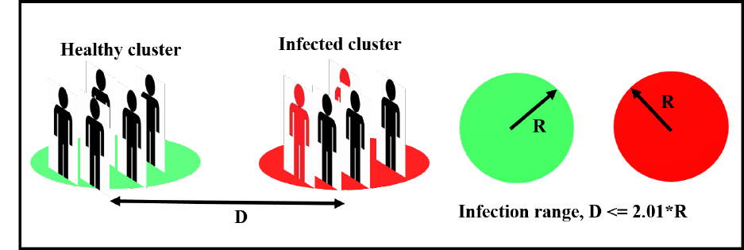
Architecture https://github.com/mittalc/Agent-Based-Simulation

Slide 7
Frameworks and Technologies
Framework Used
Netlogo
HTML, CSS (Bootstrap)– For Front-end
Technologies
Github – For code repository and issues handling
Microsoft Teams – For team discussions and meetings
Latex – Pdfs and reports

Slide 8
Future Plans
We are planning to make this a full-fledged Simulation website in future and our plans are
More test cases – Our test cases for the current version are for very basic functionalities and we plan to elaborate on that
Adding Better UI/UX – Since our current version project has a good groundwork we plan to now focus on the UI of the project and make it more presentable
Elaborating on all distinct vaccines and different virus mutants.

